Slide 1
Zero Tolerance
September 22, 2018
Presented by Deirdre Higgins

Slide 2
Deirdre Higgins
Deirdre Higgins brings over twenty years of experience as a Human Resources executive, with expertise in recruiting, training, performance management, career development, diversity program development, employee relations, benefits, compensation, payroll, safety, leadership development and compliance issues.
Deirdre brings her work experience, education experience and global experience to her role as an executive consultant, coach, and trainer. Her background and knowledge as a Senior Human Resources Leader in the manufacturing, construction and tourism fields help her to include real life experiences in her training programs.
Deirdre is committed to helping companies achieve greater productivity and profitability by designing and delivering strategic, practical solutions that promote teamwork, leadership accountability and diversity at all levels of an organization.
She delivers keynote presentations and interactive workshops on leadership, strategic business planning, performance and accountability, marketing, employment laws, diversity and team dynamics.
Deirdre has published numerous articles on employment laws, conflict management, employee engagement, performance management and leadership. She holds a BA in Education from Wheelock College and an MBA from Cambridge College. Deirdre is a world traveler and has been to six of the seven continents, with only Australia remaining on her bucket list.

Slide 3
Agenda
Goal of Training Session
Key Definitions
Discrimination Law
Harassment Law
Sexual Harassment Law
Consequences of Discrimination/Harassment
Process for Handling Complaints
Manager Responsibilities/Liability
Investigations
Proactive Strategies

Slide 4
Goal of Training
Create space for our theatre community to come together and reflect on these issues on both personal and professional level
Share information on the systems of support currently in place
Provide education around and tools for community-based processes for navigating these issues with humanity, compassion, and accountability

Slide 5
Why?
Unless you’ve been hiding under a rock (beneath the root of a tree, at the bottom of the ocean), you know that sexual harassment in the theatre has been a topic in the news lately. What performers and other theatre professionals may tend to forget is that while they are artists, they are also “acting” as employees, be it of a theatre company or an individual producer. And, as employees, they have certain rights under federal, state, and sometimes city employment laws.

Slide 6
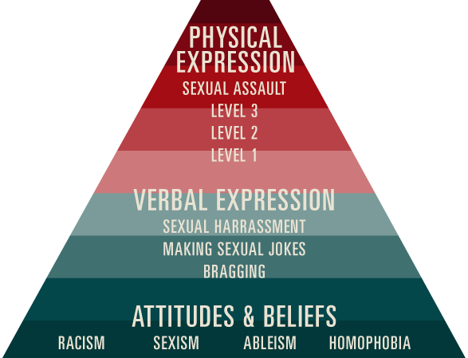

Slide 7
Discrimination Law
The federal and state anti-discrimination laws attempt to remove artificial barriers to employment opportunities that grow out of prejudice or stereotypical assumptions about groups of people based upon protected classes (e.g., gender, race, religion, sexual orientation, color, creed, age, national origin, ancestry, military or veteran status, mental or physical handicap, etc.).
An employer is expected to use neutral, job-related criteria in making all employment-related decisions.

Slide 8
Harassment
Verbal or physical conduct that denigrates or shows hostility toward a person based upon that person’s membership in a protected class and that:
Has the purpose or effect of creating a hostile work environment;
Has the purpose or effect of unreasonably interfering with the individual’s work performance; or
Otherwise adversely affects an individual’s employment opportunities.
Written or graphic material that denigrates or shows hostility toward a group because of its protected status also may constitute harassment.

Slide 9
Harassment in a Theatrical Workplace
In a theatrical context, harassment can be additionally defined as one or a series of comments or conduct of a gender-related or sexual nature outside the boundaries of consent or production content, which is known or ought reasonably be known to be unwelcome/unwanted, offensive, intimidating, hostile, or inappropriate. It is worth noting that the higher the emotional/sexual risk a production asks of its artists, the greater the diligence of each member of production and artistic staffs is needed to foster an environment of emotional safety.
Sexual harassment includes but is not limited to:
Unwelcome remarks, jokes, innuendoes, or taunts about a person's body, attire, gender, or sexual orientation outside the boundaries of consent or production content;
Negative stereotyping of race, gender, gender identity, religion, color, national origin, ancestry, marital status, sexual orientation, ability, or other status protected by law outside the boundaries of consent or production content;
Any unwanted or inappropriate physical contact such as touching, kissing, massaging, patting, hugging, or pinching outside the boundaries of consent or production content;

Slide 10
What is EMCAT Policy
Harassment
[Name of Theatre] prohibits harassment of any kind, including sexual harassment, and will take appropriate and immediate action in response to complaints or knowledge of violations of this policy. For purposes of this policy, harassment is any verbal or physical conduct designed to threaten, intimidate or coerce any cast members, production team, board member, or any person working for or on behalf of [Name of Theatre]. Verbal taunting (including racial and ethnic slurs) that, in the employee’s opinion, impairs his or her ability to perform his or her job is included in the definition of harassment. The following examples of harassment are intended to be guidelines and are not exclusive when determining whether there has been a violation of this policy:
Verbal harassment includes comments that are offensive or unwelcome regarding a person’s nationality, origin, race, color, religion, gender, sexual orientation, age, body, disability or appearance, including epithets, slurs and negative stereotyping.
Nonverbal harassment includes distribution, display or discussion of any written or graphic material that ridicules, denigrates, insults, belittles or shows hostility, aversion or disrespect toward an individual or group because of national origin, race, color, religion, age, gender, sexual orientation, pregnancy, appearance, disability, sexual identity, marital or other protected status.

Slide 11
Sexual harassment
Sexual harassment is a form of unlawful employment discrimination under Title VII of the Civil Rights Act of 1964 and is prohibited under [Name of Theatre]’s anti-harassment policy. According to the Equal Employment Opportunity Commission (EEOC), sexual harassment is defined as “unwelcome sexual advances, requests for sexual favors, and other verbal or physical conduct of a sexual nature . . . when . . . submission to or rejection of such conduct is used as the basis for employment decisions . . . or such conduct has the purpose or effect of . . . creating an intimidating, hostile or offensive working environment."
There are two types of sexual harassment:
“Quid pro quo” harassment, where submission to harassment is used as the basis for casting, membership, or employment decisions. Therefore, only someone in a supervisory capacity (with the authority to grant such benefits) can engage in quid pro quo harassment. Examples: A director promising a role to an actor, if she goes on a date with him; a board member threatening not to hire a member of the production team if he does not have sex with her.
“Hostile work environment,” where the harassment creates an offensive and unpleasant working environment. A hostile work environment can be created by anyone in the theatre, whether it be directors, other actors or audience members. Hostile environment harassment consists of verbiage of a sexual nature, unwelcome sexual materials or even unwelcome physical contact as a regular part of the work environment. Texts, e-mails, cartoons or posters of a sexual nature; vulgar or lewd comments or jokes; or unwanted touching or fondling all fall into this category.

Slide 12
True or False
Sexual harassment is really just a form of teasing.
A person can only complain about sexual harassment where a reasonable person would anticipate that the behaviour would make someone feel humiliated.
Sexual harassment has to be between people of different sexes
If a person is only joking and does not intend to harm or distress another person it cannot be called harassment
Harassment includes sending inappropriate text messages that will offend or humiliate another person

Slide 13
True or False
If you observe harassment taking place in the workplace, it is best to let the people involved deal with it between themselves.
You can be held personally liable in court for certain harassment claims.
Using slang “nicknames” that denote co-workers’ race, ethnicity, cultural heritage, religion, sex or age is okay, as long as it is done in a joking manner.
OK in the workplace?
OK at a barbeque party?

Slide 14
True or False
One incident of unwelcome conduct cannot support a violation.
If you report discriminatory or inappropriate conduct, it will become public knowledge.
If a victim of sexual harassment requests to the director that they not file a report and that they can handle the situation themselves, the director should agree to the victim’s wishes.
It’s against the law for a director to refuse to cast a woman for a “male” role?

Slide 15
TRUE OR FALSE
You are not responsible if harassment happens during a cast party
It is okay for cast members , directors or producers ask a co-worker on a date
There is nothing you can do if an audience member harasses a cast member :
During the show?
After the show?

Slide 16
Is This a Hostile Work Environment?
It is clear you do not need to touch someone to harass them. And in artistic industries where the bullying is usually treated as the necessary by product of creativity.
We have excused bad behavior on a wide spectrum, for a long time. I’ve heard an artistic director say, “ It’s awful this person can’t do a show without screaming at people. But they are brilliant and we are going to work with them anyway.”

Slide 17
Ways to Protect Yourself and Your Cast
Even in the tiniest of spaces, privacy and concentration are important when preparing for performance. We will endeavor to create a dressing room environment where all inhabitants recognize these values and participate in fostering a safe place for artists to prepare.
Children under the age of 18 should be given private dressing room accommodations whenever possible.
Reasonable accommodations should be made to respect individual modesty, and designated space should be provided for participants to change clothes and prepare for their performance. This space will be referred to as a dressing room, even if it’s not an entire room.

Slide 18
Try not to be alone with a child actor – have someone else in theatre in possible or have keep doors opened
When a sexual in nature or nude scene is required ensure that actors know in advance and be sensitive to their comfort level
Allow a private or covered dressing area for an actor who does not feel comfortable changing in front of others
When in doubt call EMCAT

Slide 19
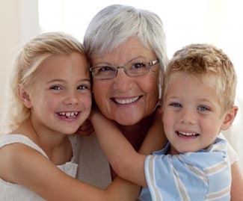
Most Important
When thinking about your words and actions or listening to a complaint – think:
How would I feel if this was said or happened to my mother, daughter, son or best friend?

Slide 21
HARRASMENT JEOPARDY

